Slide 1


Slide 2

Face Mask Recognition
Vojislav Mladenović
Olivera Popović
www.linkedin.com/in/vojislav-mladenovic-1264006b/
www.linkedin.com/in/olivera-popovic/

Slide 3
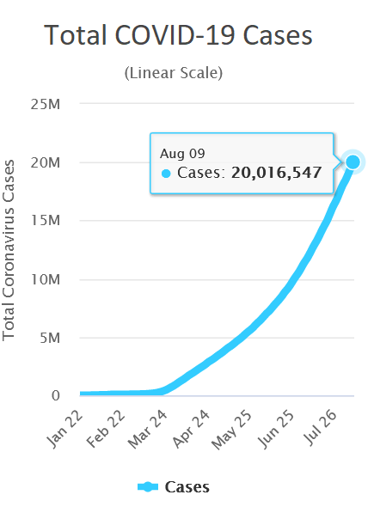
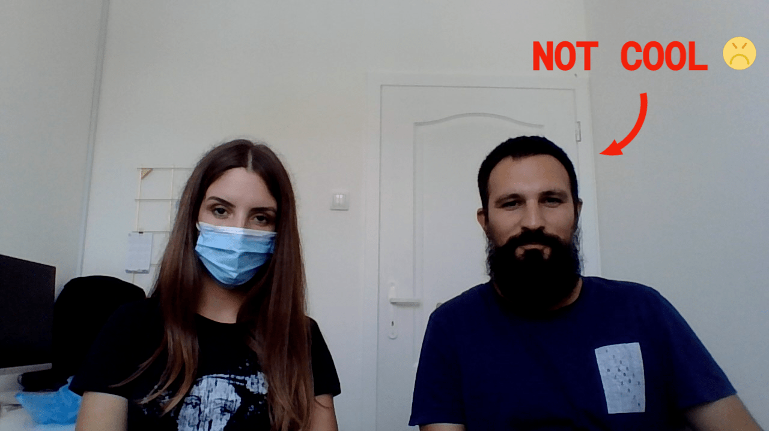
Problem and Motivation
Real time, video and image mask detection

Slide 4
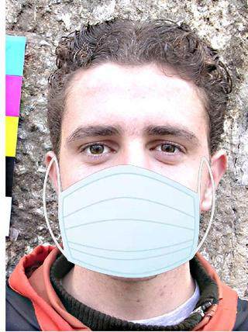
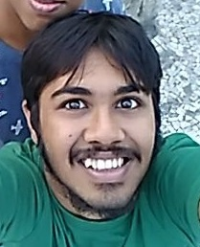
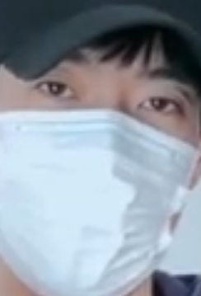

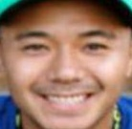
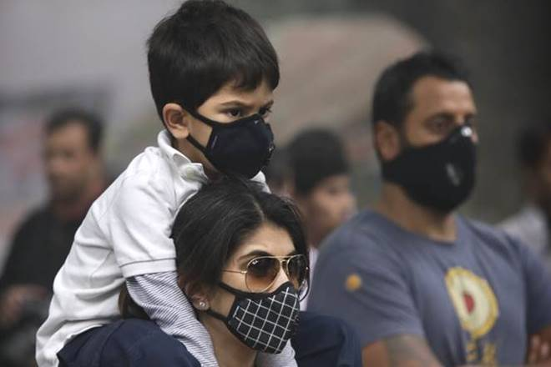
Dataset
Dataset has 4530 images of people (2606 with masks, 1924 without masks)
Most of the faces are narrowly cropped
About ¼ of images are with computer generated masks
There are augmented images (added noise, rotated, changed colors)
Small number of group images
Masks are in multiple colors

Slide 5
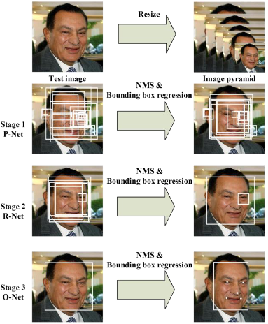
Model
Face detector and classifier
Finetuned pretrained MobileNetV2 as face classifier Added layers:
Linear layer with ReLU activation
Dropout with 0.5 probability
Linear layer with Softmax activation function
Pretrained Multi-task Cascaded Convolutional Neural Network (MTCNN) as face and landmark detector
Figure: Model Scheme of MTCNN
K. Zhang, Z. Zhang, Z. Li and Y. Qiao, "Joint Face Detection and Alignment Using Multitask Cascaded Convolutional Networks," in IEEE Signal Processing Letters, vol. 23, no. 10, pp. 1499-1503, Oct. 2016, doi: 10.1109/LSP.2016.2603342.

Slide 6
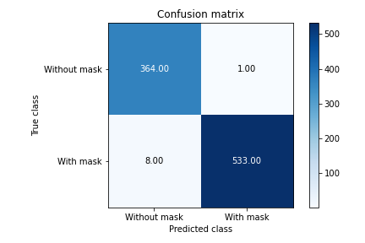
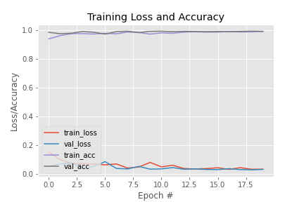
Metrics
Accuracy: 0.99, Precision 0.998, Recall 0.985
Number of epochs 20

Slide 7
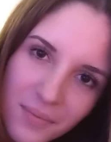

Experiments
Tried on images, videos and camera. Conclusion:
Lighting is very important (model works best at daylight)
Model is confused with beards, covered mouth and profile view
Model has good performance on CPU (enough for real time detection)
Experimented with different probability thresholds
Used landmarks for face alignment

Slide 8

Aplication

Slide 9
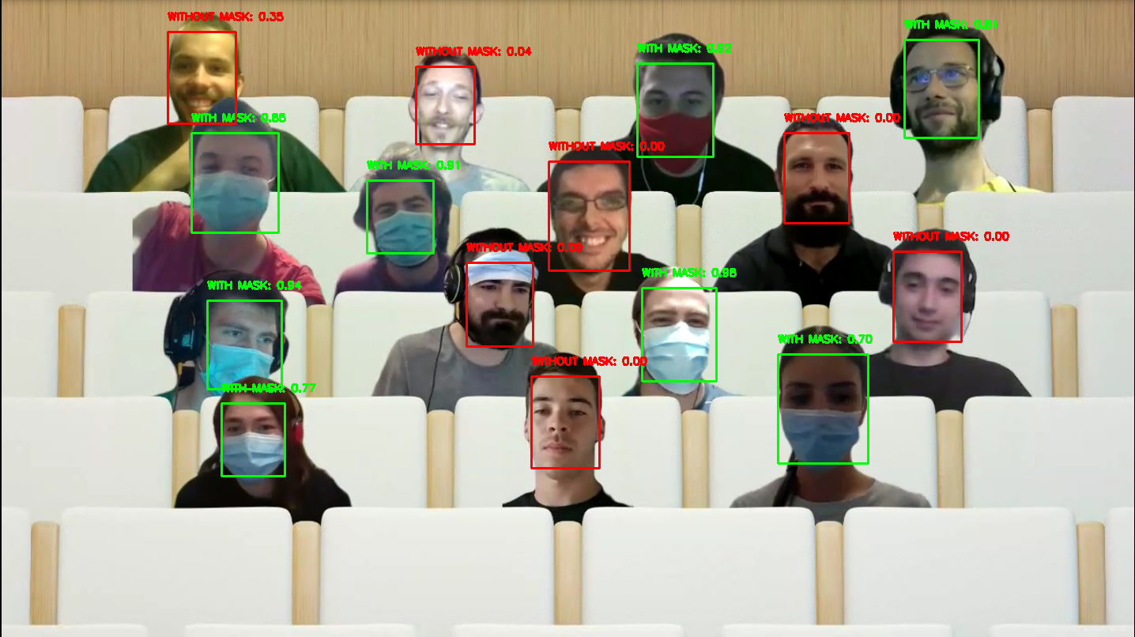
Aplication

Slide 10


Slide 11

Code available at: https://github.com/popovic-olivera/face-mask-detection

